Slide 1
MEMORY CORRUPTION ATTACKS Vitaly Shmatikov

Slide 2

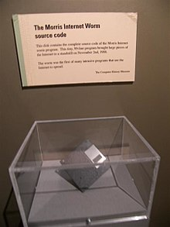
The Morris Worm
Famous CS prof at MIT,
founder of the Y-combinator
Released in 1988 by Robert Morris
Graduate student at Cornell, son of the NSA chief scientist
First person convicted under the Computer Fraud and Abuse Act (3 years of probation and 400 hours of community service)
Morris claimed it was intended to harmlessly measure the Internet, but it created new copies as fast as it could and overloaded infected hosts
$10-100M worth of damage
Floppy with the source code of the Morris worm, Computer History Museum

Slide 3
Famous Internet Worms
Highest fraction of the Internet infected
Morris worm (1988): overflow in fingerd
6,000 machines infected (10% of existing Internet)
CodeRed (2001): overflow in MS-IIS server
300,000 machines infected in 14 hours
SQL Slammer (2003): overflow in MS-SQL server
75,000 machines infected in 10 minutes (!!)
Sasser (2004): overflow in Windows LSASS
Around 500,000 machines infected
Fastest
Responsible for user
authentication in Windows

Slide 4
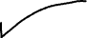
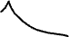
And The Band Marches On
Largest number of machines infected
Conficker (2008-09): overflow in Windows RPC
Around 10 million machines infected (estimates vary)
Stuxnet (2009-10): several zero-day overflows + same Windows RPC overflow as Conficker
Windows print spooler service, LNK shortcut display, task scheduler
Flame (2010-12): same print spooler and LNK overflows as Stuxnet
Most sophisticated (?) cyberespionage virus

Slide 5
EternalBlue
Integer overflow
Buffer overflow
Heap spraying
A complex memory exploit developed by NSA
Targets Microsoft’s implementation of SMB in multiple versions of Windows, Siemens medical equipment, etc.
Leaked by “Shadow Brokers” in April 2017
Used by WannaCry ransomware and NotPetya
North Korean attack; 200,000 victims, including major impact on NHS hospitals in the UK
Major cyberattack on Ukraine that propagated to other countries, estimated $10 billion damage

Slide 6
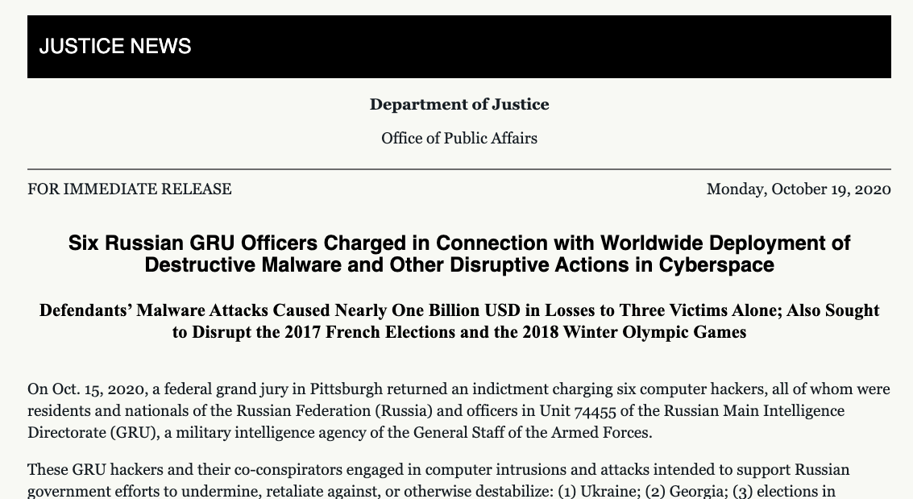

Their computer attacks used some of the world’s most destructive malware to date, including: KillDisk and Industroyer, which each caused blackouts in Ukraine; NotPetya, which caused nearly $1 billion in losses to the three victims identified in the indictment alone; and Olympic Destroyer, which disrupted thousands of computers used to support the 2018 PyeongChang Winter Olympics.

Slide 7
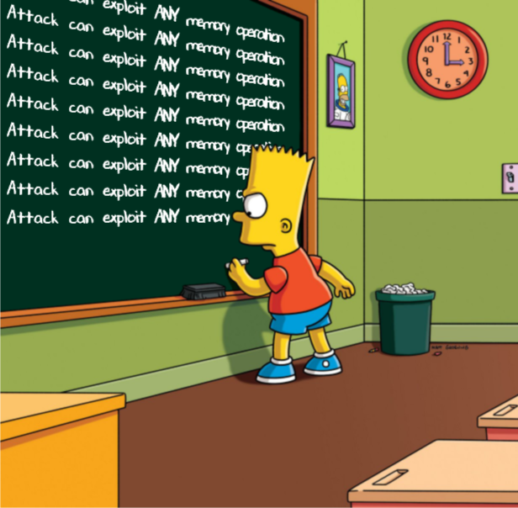
Memory Exploits
Pointer assignment, format strings, memory allocation and de-allocation, function pointers, calls to library functions via offset tables …
Buffer is a data storage area inside computer memory (stack or heap)
Intended to hold pre-defined amount of data
Simplest exploit: supply executable code as “data”, trick victim’s machine into executing it
Code will self-propagate or give attacker control over machine
In general, attack need not involve code injection or data execution!

Slide 8
Running Example

Slide 9
This program will run as root!

Slide 10
Executing Machine Code
Compiler (gcc)
C code of simplified meet.c
Disassembled machine code for main

Slide 11
Executing Machine Code
Program state includes
CPU registers (32-bit on x86)
Memory (heap and stack)
Execute instructions one by one, using and modifying state

Slide 12
x86 Registers
32 bits
EAX
AX
AH
AL
EBX
BX
BH
BL
ECX
CX
CH
CL
EDX
DX
DH
DL
ESI
EDI
ESP
(stack pointer)
EBP
(base pointer)

Slide 13
Executing Machine Code
Program state includes
CPU registers (32-bit on x86)
Memory (heap and stack)
Execute instructions one by one, using and modifying state
Example: add $0x4,%eax
This adds 4 to the value in the EAX register
Example: nop
Single-byte (0x90) “no op” instruction, does nothing!

Slide 14
Process Memory Layout
unused space
.text
.data
.bss
heap
stack
Env
Low memory
addresses
High memory
addresses
.text: machine code of executable
.data: global initialized variables
.bss: “below stack section”
global uninitialized variables
heap: dynamic variables
stack: local variables, track func calls
Env: environment variables, arguments to program

Slide 15
Stack Buffers
Suppose a Web server contains this function
void func(char *str) {
char buf[126];
strcpy(buf,str);
}
When this function is invoked, a new frame (activation record) is pushed onto the stack
Allocate local buffer
(126 bytes reserved on stack)
Copy argument into local buffer

Slide 16
Frame Layout
void func(char *str) {
char buf[126];
strcpy(buf,str);
}
Stack grows this way
buf
sfp
ret
addr
str
Frame of the
calling function
Top of
stack
Local variables
Pointer to
previous frame
Arguments
Saved EIP:
Execute code at this address after func() finishes

Slide 17
Function Call in meet.c
stack base pointer
(EBP)
stack base pointer
(EBP)
greeting local var name
main EBP
main EIP + 5
argv[1]
main local vars
…
Low memory
addresses
High memory
addresses
stack pointer
(ESP)
stack pointer
(ESP)
stack pointer
(ESP)
stack pointer
(ESP)
eip
eip
eip
Pushing argv[1] onto stack
…. (more stuff including strcpy) …
eip
eip
eip
eip

Slide 18
What If Buffer Is Overstuffed?
Memory pointed to by str is copied onto stack…
void func(char *str) {
char buf[126];
strcpy(buf,str);
}
If a string longer than 126 bytes is copied into buffer, it will overwrite adjacent stack locations
strcpy does NOT check whether the string
at *str contains fewer than 126 characters
buf
overflow
str
Frame of the
calling function
Top of
stack
This will be interpreted as the return address!

Slide 19
Smashing the Stack
stack base pointer
(EBP)
greeting local var name
Adversarial values
main EBP
Bad
EBP
main EIP + 5
Bad
EIP
argv[1]
main local vars
…
Low memory
addresses
High memory
addresses
stack pointer
(ESP)
stack pointer
(ESP)
stack pointer
(ESP)
Bad eip
????
Pushing argv[1] onto stack
…. (more stuff including strcpy) …
eip
eip

Slide 20
Targets of Stack Smashing
greeting local var name
Adversarial values
main EBP
main EIP + 5
argv[1]
main local vars
…
Bad
EBP
Bad
EIP
Overwriting EBP
When greeting() returns, stack is corrupted because stack frame points to wrong address
Overwriting EIP
When greeting() returns, will jump to address pointed to by the EIP value “saved” on stack

Slide 21
Control-Flow Hijacking
When greeting() returns, jumps
to address pointed to by Bad EIP
Have EIP point back into adversarial buffer
Make buffer include executable machine code
greeting local var name
Adversarial values
main EBP
Bad
EBP
main EIP +2
Bad
EIP
argv[1]
main local vars
…
Low memory
addresses
High memory
addresses

Slide 22
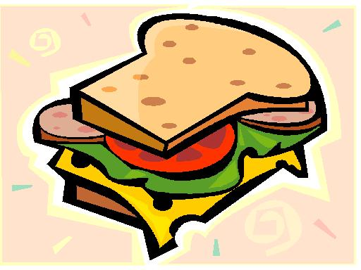
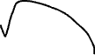


Building an Exploit
machine code
ptr
executable machine code
pointer to this code

Slide 23
Building Shell Code
#include <stdio.h>
void main() {
char *name[2];
name[0] = "/bin/sh";
name[1] = NULL;
execve(name[0], name, NULL);
exit(0);
}
movl string addr,string_addr_addr
movb $0x0,null_byte_addr
movl $0x0,null_addr
movl $0xb,%eax
movl string_addr,%ebx
leal string_addr,%ecx
leal null_string,%edx
int $0x80
movl $0x1, %eax
movl $0x0, %ebx
int $0x80
/bin/sh string goes here.
Shell code from AlephOne

Slide 24
Building Shell Code
jmp offset-to-call # 2 bytes
popl %esi # 1 byte
movl %esi,array-offset(%esi) # 3 bytes
movb $0x0,nullbyteoffset(%esi) # 4 bytes
movl $0x0,null-offset(%esi) # 7 bytes
movl $0xb,%eax # 5 bytes
movl %esi,%ebx # 2 bytes
leal array-offset,(%esi),%ecx # 3 bytes
leal null-offset(%esi),%edx # 3 bytes
int $0x80 # 2 bytes
movl $0x1, %eax # 5 bytes
movl $0x0, %ebx # 5 bytes
int $0x80 # 2 bytes
call offset-to-popl # 5 bytes
/bin/sh string goes here
empty # 4 bytes
jmp
more code
call
popl
“/bin/sh”
empty
address of “/bin/sh”
ptr

Slide 25
Building Shell Code
char shellcode[] =
"\xeb\x2a\x5e\x89\x76\x08\xc6\x46\x07\x00\xc7\x46\x0c\x00\x00\x00"
"\x00\xb8\x0b\x00\x00\x00\x89\xf3\x8d\x4e\x08\x8d\x56\x0c\xcd\x80"
"\xb8\x01\x00\x00\x00\xbb\x00\x00\x00\x00\xcd\x80\xe8\xd1\xff\xff"
"\xff\x2f\x62\x69\x6e\x2f\x73\x68\x00\x89\xec\x5d\xc3";
Another issue:
strcpy stops when it hits a NULL byte
Solution:
Alternative machine code that avoids NULLs

Slide 26
Shell Code
char shellcode[] =
"\xeb\x1f\x5e\x89\x76\x08\x31\xc0\x88\x46\x07\x89\x46\x0c\xb0\x0b"
"\x89\xf3\x8d\x4e\x08\x8d\x56\x0c\xcd\x80\x31\xdb\x89\xd8\x40\xcd"
"\x80\xe8\xdc\xff\xff\xff/bin/sh"

Slide 27
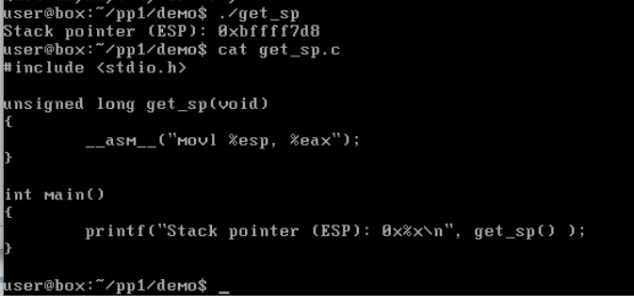
Crude Way to Get Stack Pointer
jmp
more code
call
popl
“/bin/sh”
empty
address of “/bin/sh”
ptr
How do we know what to set ptr (Bad EIP) to?

Slide 28

NOP Sled
jmp
call
popl
“/bin/sh”
empty
ptr
ptr
NOPs
more code
address of “/bin/sh”
ptr
We can use a nop sled to make the arithmetic easier
Instruction “xchg %eax,%eax” which has opcode \x90
Land anywhere in NOPs, and we are good to go
Can also add lots of copies of ptr at end

Slide 29
Small Buffers
What if 400 is changed to a small value, say 10?
jmp
call
popl
“/bin/sh”
empty
ptr
ptr
NOPs
more code
address of “/bin/sh”
ptr

Slide 30
Dealing with Small Buffers
Use an environment variable to store the exploit buffer
execve(“meet”, argv, envp)
Normally, bash passes in the envp array from your shell’s environment
Can also pass it in explicitly via execve()
array of pointers to strings (just like argv)
.text
.data
.bss
Env.
heap
stack
Low memory
addresses
High memory
addresses

Slide 31
Dealing with Small Buffers
Overwrite saved return address with ptr to environment variable holding attack code
jmp
call
popl
“/bin/sh”
empty
ptr
NOPs
more code
address of “/bin/sh”
.text
.data
.bss
Env.
heap
stack
Low memory
addresses
High memory
addresses

Slide 32
Stack Corruption: General View
val1
val2
arguments (funcp)
return address
Saved Frame Pointer
pointer var (ptr)
buffer (buf)
int bar (int val1) {
int val2;
foo (a_function_pointer);
}
String grows
Attacker-controlled memory
int foo (void (*funcp)()) {
char* ptr = point_to_an_array;
char buf[128];
gets (buf);
strncpy(ptr, buf, 8);
(*funcp)();
}
Stack grows

Slide 33
Cause: No Range Checking
strcpy does not check input size
strcpy(buf, str) simply copies memory contents into buf starting from *str until “\0” is encountered, ignoring the size of the area allocated to buf
Many all C library functions are unsafe
strcpy(char *dest, const char *src)
strcat(char *dest, const char *src)
gets(char *s)
scanf(const char *format, …)
printf(const char *format, …)

Slide 34
Attack #1: Return Address
args (funcp)
return address
PFP
pointer var (ptr)
buffer (buf)
② set stack pointers to return to a dangerous library function
Attack code
“/bin/sh”
①
system()
Change the return address to point to the attack code. After the function returns, control is transferred to the attack code.
… or return-to-libc: use existing instructions in the code segment such as system(), exec(), etc. as the attack code.

Slide 35
Function Pointer Overflow
C uses function pointers for callbacks: if pointer to F is stored in memory location P, then another function G can call F as (*P)(…)
Buffer with attacker-supplied
input string
Callback
pointer
attack code
overflow
Legitimate function F
(elsewhere in memory)

Slide 36
Attack #2: Pointer Variables
args (funcp)
return address
SFP
pointer var (ptr)
buffer (buf)
Attack code
Global Offset Table
Syscall pointer
Change a function pointer to point to attack code
Any memory, on or off the stack, can be modified by a statement that stores a value into the compromised pointer
strcpy(buf, str);
*ptr = buf[0];

Slide 37
Off-By-One Overflow
Home-brewed range-checking string copy
void notSoSafeCopy(char *input) {
char buffer[512]; int i;
for (i=0; i<=512; i++)
buffer[i] = input[i];
}
void main(int argc, char *argv[]) {
if (argc==2)
notSoSafeCopy(argv[1]);
}
This will copy 513 characters into the buffer. Oops!
1-byte overflow: can’t change saved EIP, but can change saved pointer to previous stack frame…
On a little-endian architecture, make it point back into the buffer…
… then caller’s saved EIP will be read from the buffer!

Slide 38
Attack #3: Frame Pointer
args (funcp)
return address
SFP
pointer var (ptr)
buffer (buf)
Fake return address
Fake SFP
Attack code
Arranged like a
real frame
Change the caller’s saved frame pointer to point
to attacker-controlled memory.
Caller’s return address will be read from this memory.

Slide 39
Two’s Complement
1
0
0
0
0
…
0
1
Binary representation of negative integers
Represent X (where X<0) as 2^{N}-|X|
N is word size (e.g., 32 bits on x86 architecture)
2³¹-1
0
1
1
1
…
1
1
+1
-1
1
1
1
1
…
1
1
2³¹ ??
-2
1
1
1
1
…
1
0
-2³¹
1
0
0
0
…
0
0

Slide 40
Integer Overflow
static int getpeername1(p, uap, compat) {
// In FreeBSD kernel, retrieves address of peer to which a socket is connected
…
struct sockaddr *sa;
…
len = MIN(len, sa->sa_len);
… copyout(sa, (caddr_t)uap->asa, (u_int)len);
…
}
Checks that “len” is not too big
Negative “len” will always pass this check…
… interpreted as a huge
unsigned integer here
… will copy up to 4G of
kernel memory to user space

Slide 41
#include <stdio.h>
#include <string.h>
int main(int argc, char *argv[]){
unsigned short s;
int i;
char buf[80];
if(argc < 3){
return -1;
}
i = atoi(argv[1]);
s = i;
if(s >= 80) { /* [w1] */
printf("Oh no you don't!\n");
return -1;
}
printf("s = %d\n", s);
memcpy(buf, argv[2], i);
buf[i] = '\0’;
printf("%s\n", buf);
return 0;
}
nova:signed {100} ./width1 5 hello
s = 5
hello
nova:signed {101} ./width1 80 hello
Oh no you don't!
nova:signed {102} ./width1 65536 hello
s = 0
Segmentation fault (core dumped)

Slide 42
Another Integer Overflow
void func( char *buf1, *buf2, unsigned int len1, len2) {
char temp[256];
if (len1 + len2 > 256) {return -1} // length check
memcpy(temp, buf1, len1); // cat buffers
memcpy(temp+len1, buf2, len2);
do-something(temp); // do stuff
}
What if len1 = 0x80, len2 = 0xffffff80 ?
⇒ len1+len2 = 0
Second memcpy() will overflow heap !!

Slide 43
Integer Overflow Exploit Stats

Slide 44
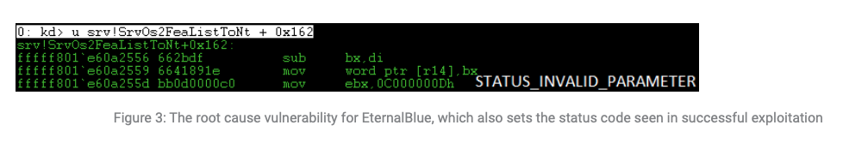
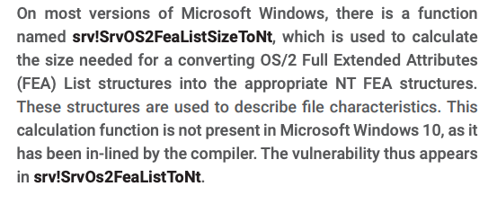
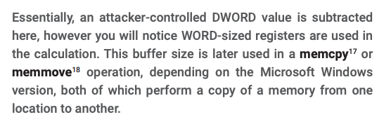
Integer Overflow in EternalBlue
https://risksense.com/wp-content/uploads/2018/05/White-Paper_Eternal-Blue.pdf

Slide 45
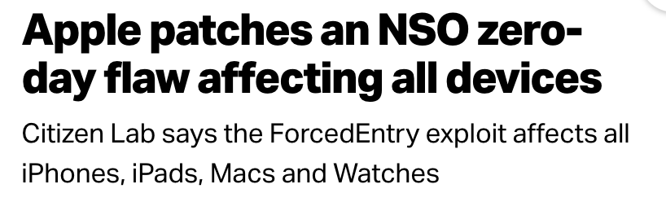
Remember the emergency Apple update on September 13, 2021?
Based on an integer overflow vulnerability in Apple’s CoreGraphics image rendering library
https://techcrunch.com/2021/09/13/apple-zero-day-nso-pegasus/

Slide 46
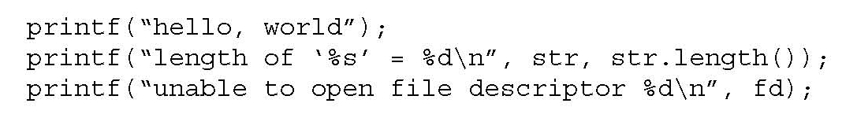
Variable Arguments in C
In C, can define a function with a variable number of arguments
Example: void printf(const char* format, …)
Format specification encoded by special % characters
%d,%i,%o,%u,%x,%X – integer argument
%s – string argument
%p – pointer argument (void *)
Several others

Slide 47
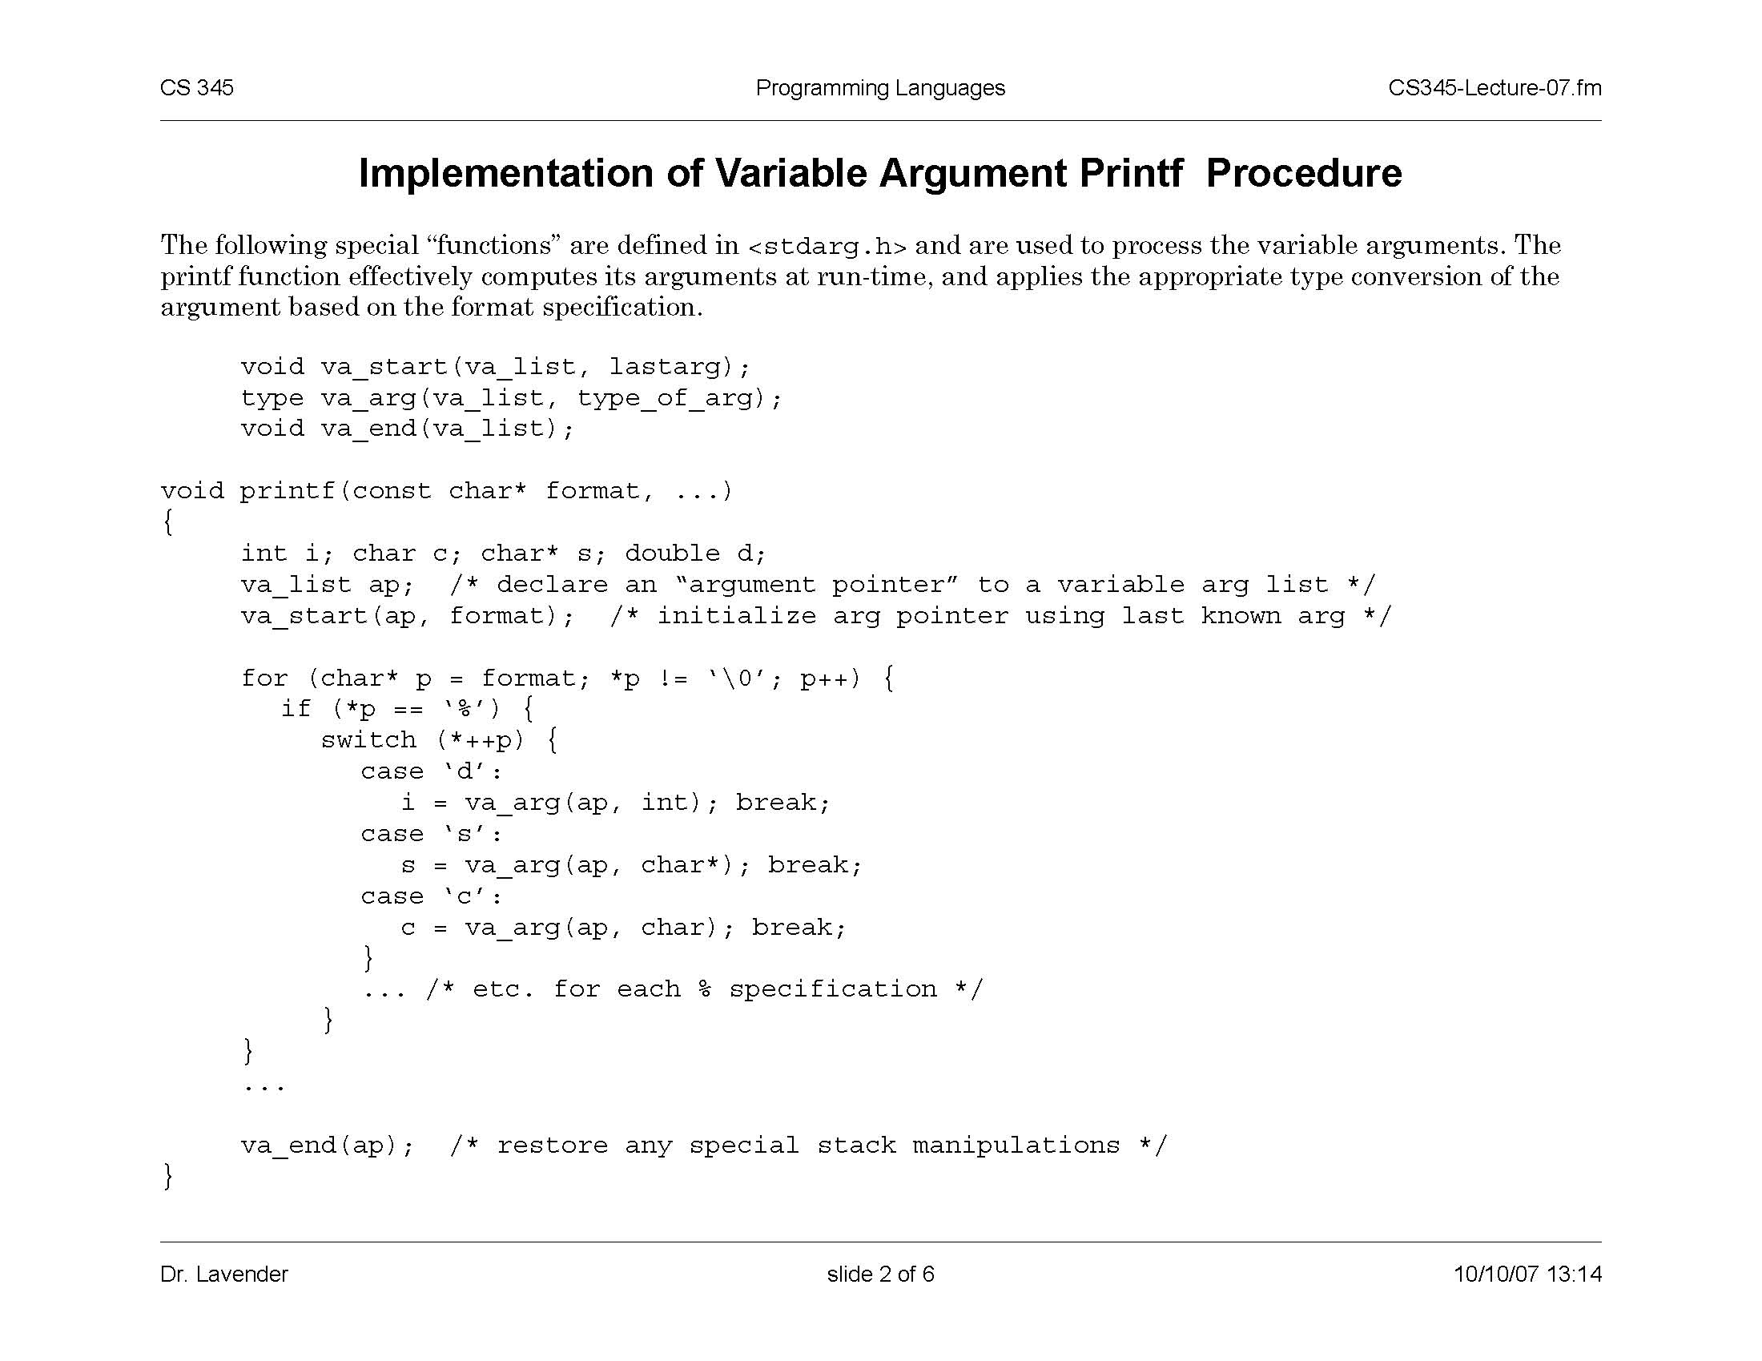
Implementation of Variable Args
Special functions va_start, va_arg, va_end compute arguments at run-time
printf has an internal
stack pointer

Slide 48
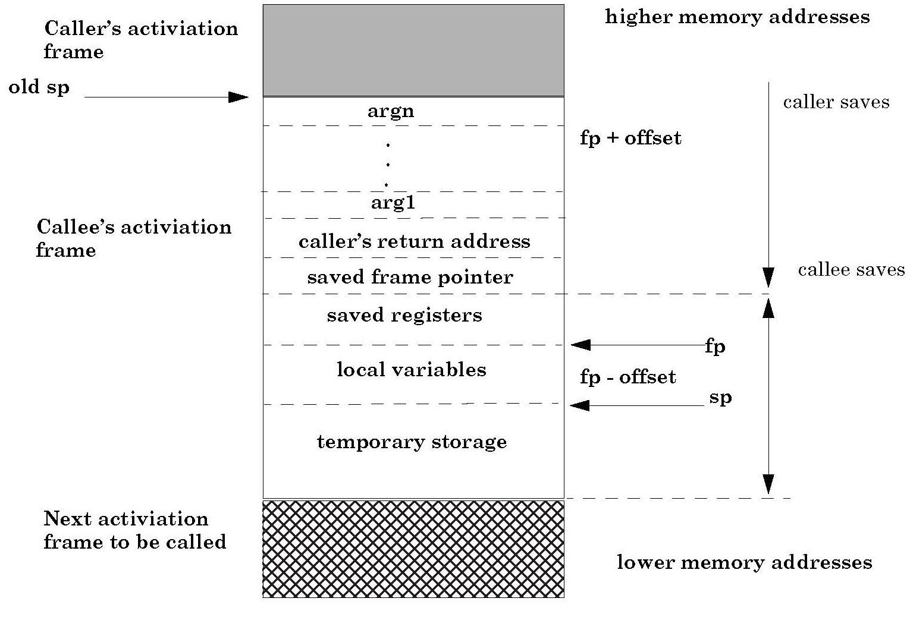
Frame with Variable Args
va_arg(ap,type)
retrieves next arg
from offset ap
va_start computes
location on the stack
past last statically
known argument

Slide 49
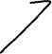
Sloppy Use of Format Strings in C
This will print
foo = 1234 in decimal, 4D2 in hex
Proper use of printf format string:
int foo=1234;
printf(“foo = %d in decimal, %X in hex”,foo,foo);
Sloppy use of printf format string:
char buf[13]=“Hello, world!”;
printf(buf); // should of used printf(“%s”, buf); …
If the buffer contains a format symbol starting with %, the location pointed to by printf’s internal stack pointer will be interpreted as an argument of printf
This can be exploited to move printf’s internal stack pointer. How?

Slide 50
Writing the Stack with Format Strings
%n format symbol tells printf to write the number of characters that have been printed
… printf(“Overflow this!%n”,&myVar); …
What if printf does not have an argument?
… char buf[16]=“Overflow this!%n”;
printf(buf); …
Argument of printf is interpeted as the destination address
14 is written into myVar (why?)
Stack location pointed to by printf’s internal stack pointer will be interpreted as the address into which the number of characters will be written!

Slide 51
Using %n to Write the Return Address
see “Exploiting Format String Vulnerabilities” for details
This portion contains
enough % symbols
to advance printf’s
internal stack pointer
Buffer with attacker-supplied
input string
“… attackString%n”, attack code
&RET
&RET+1
RET
Number of characters in
attackString must be
equal to … what?
Overwrite location under printf’s stack
pointer with the address of RET;
printf(buffer) will write the number of
characters in attackString into RET
Return execution to this address
C has a concise way of printing multiple symbols: %Mx will print exactly 4M bytes (taking them from the stack). Attack string should contain enough “%Mx” so that the number of characters printed is equal to the most significant byte of the address of the attack code.
Repeat three times (four “%n” in total) to write into &RET+1, &RET+2, &RET+3, thus replacing RET with the address of the attack code byte by byte.

Slide 52



Heap Overflow
Overflowing heap memory can change important pointers
File pointers
Example: replace a filename pointer with a pointer into a memory location containing the name of a system file (instead of a temporary file, write into AUTOEXEC.BAT)
Function pointers
Any memory write where the attacker controls the value and the destination can lead to control hijacking

Slide 53
Function Pointers on the Heap
Compiler-generated function pointers
(e.g., virtual method table in C++ or JavaScript code)
vtable
method #1
FP1
Suppose vtable is on the heap next to a string object
method #2
FP2
FP3
method #3
buf[256]
vtable
ptr
data
object T

Slide 54
Heap-Based Control Hijacking
Compiler-generated function pointers
(e.g., virtual method table in C++ or JavaScript code)
vtable
method #1
FP1
shell code
Suppose vtable is on the heap next to a string object
method #2
FP2
FP3
method #3
buf[256]
vtable
ptr
data
object T

Slide 55
Dynamic Memory Management in C
Memory allocation: malloc(size_t n)
Allocates n bytes and returns a pointer to the allocated memory; memory not cleared
Also calloc(), realloc()
Memory deallocation: free(void * p)
Frees the memory space pointed to by p, which must have been returned by a previous call to malloc(), calloc(), or realloc()
If free(p) has already been called before, undefined behavior occurs
If p is NULL, no operation is performed

Slide 56
Memory Management Errors
Initialization errors
Failing to check return values
Writing to already freed memory
Freeing the same memory more than once
Improperly paired memory management functions (example: malloc / delete)
Failure to distinguish scalars and arrays
Improper use of allocation functions
All result in exploitable vulnerabilities

Slide 57
IE11 Example: CVE-2014-0282 (simplified)
<form id="form"> <textarea id="c1" name="a1" ></textarea> <input id="c2" type="text" name="a2” value="val">
</form>
<script>
function changer() {
document.getElementById("form").innerHTML = "";
CollectGarbage(); // erase c1 and c2 fields
}
document.getElementById("c1").onpropertychange = changer;
document.getElementById("form").reset();
</script>
Loop on form elements:
c1.doReset()
c2.doReset()

Slide 58
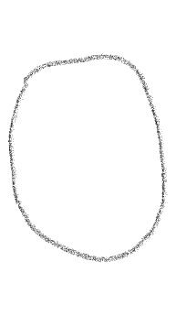
Use After Free
c1.doReset() causes changer() to be called and free object c2
object c2
doSomething
FP1
vptr
FP2
doReset
FP3
doSomethingElse
data
vtable
Freed and marked as available for future allocations

Slide 59
What Just Happened?
c1.doReset() causes changer() to be called and free object c2
object c2
FP1
vptr
FP2
ShellCode
FP3
data
vtable
Suppose attacker allocates an object and gets the same memory that was previously occupied by vtable
When c2.doReset() is called, attacker gets shell

Slide 60
The Exploit
<script>
function changer() {
document.getElementById(”form").innerHTML = "";
CollectGarbage();
--- allocate string object to occupy vtable location ---
}
document.getElementById("c1").onpropertychange = changer;
document.getElementById("form").reset();
</script>

Slide 61
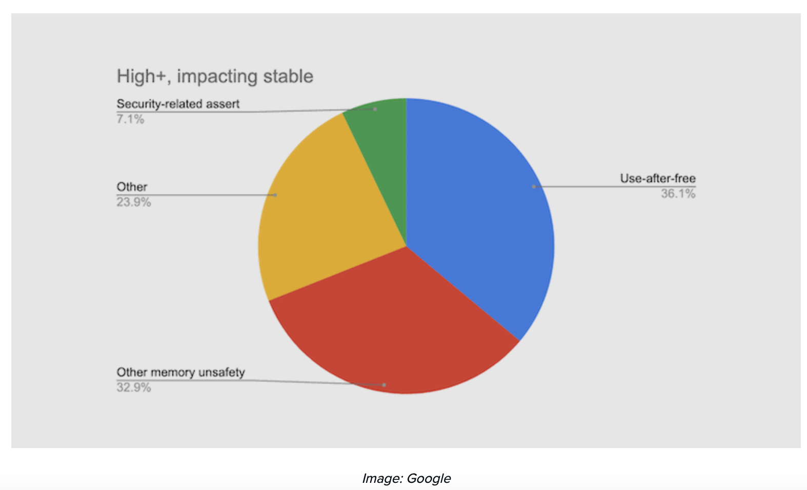
Chrome Vulnerabilities (2015-2020)

Slide 62
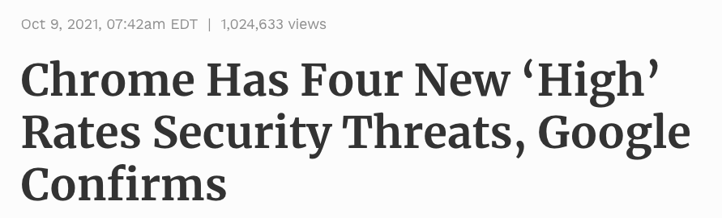
High - CVE-2021-37977 : Use after free in Garbage Collection. Reported by Anonymous on 2021-09-24
High - CVE-2021-37978 : Heap buffer overflow in Blink. Reported by Yangkang (@dnpushme) of 360 ATA on 2021-08-04
High - CVE-2021-37979 : Heap buffer overflow in WebRTC. Reported by Marcin Towalski of Cisco Talos on 2021-09-07
High - CVE-2021-37980 : Inappropriate implementation in Sandbox. Reported by Yonghwi Jin (@jinmo123) on 2021-09-30
https://www.forbes.com/sites/gordonkelly/2021/10/09/google-chrome-hack-new-attack-upgrade-chrome-now/

Slide 63

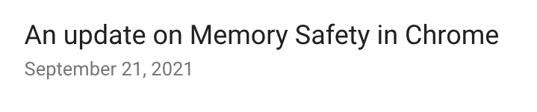
Last year, we showed that more than 70% of our severe security bugs are memory safety problems.
…
Chrome has been exploring three broad avenues to seize this opportunity:
Make C++ safer through compile-time checks that pointers are correct.
Make C++ safer through runtime checks that pointers are correct.
Investigating use of a memory safe language for parts of our codebase.
In each case, we hope to eliminate a sizable fraction of our exploitable security bugs, but we also expect some performance penalty
https://security.googleblog.com/2021/09/an-update-on-memory-safety-in-chrome.html

Slide 64
Doug Lea’s Memory Allocator
The GNU C library and most versions of Linux are based on Doug Lea’s malloc (dlmalloc) as the default native version of malloc

Slide 65
Free Chunks in dlmalloc
Organized into circular double-linked lists (bins)
Each chunk on a free list contains forward and back pointers to the next and previous chunks in the list
These pointers in a free chunk occupy the same eight bytes of memory as user data in an allocated chunk
Chunk size is stored in the last four bytes of the free chunk
Enables adjacent free chunks to be consolidated to avoid fragmentation of memory

Slide 66
Responding to Malloc
Best-fit method
An area with m bytes is selected, where m is the smallest available chunk of contiguous memory equal to or larger than n (requested allocation)
First-fit method
Returns the first chunk encountered containing n or more bytes
Prevention of fragmentation
Memory manager may allocate chunks that are larger than the requested size if the space remaining is too small to be useful

Slide 67
The Unlink Macro
What if the allocator is confused
and this chunk has actually
been allocated…
… and user data written into it?
#define unlink(P, BK, FD) {
FD = P->fd;
BK = P->bk;
FD->bk = BK;
BK->fd = FD;
}
Hmm… memory copy…
Address of destination read from the free chunk
The value to write also read from the free chunk
Removes a chunk from a free list -when?

Slide 68
Example of Unlink
What if this area
contained user data?

Slide 69
Double-Free Vulnerabilities
Freeing the same chunk of memory twice, without it being reallocated in between
Start with a simple case:
The chunk to be freed is isolated in memory
The bin (double-linked list) into which the chunk will be placed is empty

Slide 70
Empty Bin and Allocated Chunk

Slide 71
After First Call to free()

Slide 72
After Second Call to free()

Slide 73
After malloc() Has Been Called
This chunk is
unlinked from
free list… how?
After malloc, user data
will be written here

Slide 74
After Another malloc()
Same chunk will
be returned…
(why?)
After another malloc,
pointers will be read
from here as if it were
a free chunk (why?)
One will be interpreted as address,
the other as value (why?)

